Slide 1
C++ Part II
X52.9265-01
Yedidiah Solowiejczyk
Week#4
New York University
School
of
Professional and Continuous Studies
C++ Part II - Week#4

Slide 2
Synopsis
Review of Overloaded Operators
  Member Functions
  Friend functions
  Global Functions
  Overloading Unary Operators
  Overloading Binary Operators
  Assignment Operators
  Miscellaneous Operators
    new( ) & delete( )
  Examples
Static
  Member Variables
  Static Member Functions
Constant
  Constant Member Functions
Pointers
  Pointer Variables
  Basic Memory Management
  Dangling Pointers
  Dynamic Variables and Automatic Variables
  Uses for Pointers
  The this Pointer
  The -> Operator
DYNAMIC ARRAYS
  Array Variables and Pointer Variables
  Creating and Using Dynamic Arrays
EXAMPLE:
  A Function That Returns an Array
Pointer Arithmetic
  Addition
  Subtraction
Multidimensional Dynamic Arrays
C++ Part II - Week#4

Slide 3
Static Member Variables
Static member variables
  All objects of class "share" one copy
  When one object changes it ➔ all see change
Useful for "tracking” purposes
  How often a member function is called
  How many objects exist at given time
  Setting a “on” flag – hardware initialization
Static member variables are global by nature but are limited to have class scope
Declaring static
static int count; //count shared amongst all
C++ Part II - Week#4

Slide 4
Static Member Variables
Static member variables obey same access specifier rules as standard member variables
Example
class student{
private:
  char name[32];
  int id;
  int grade;
  static int count;
public:
// …..
static float hst_grade;
};
//initialize static variables outside
// class definition - init only once
student::count = 0;
student::hst_grade = 0;
int main()
{ student X, S[10];
::::::::::::::::::::::::::
cout << student::hst_grade; //OK
//need static member function
cout << student::count; //!OK
}
C++ Part II - Week#4

Slide 5
Static Member Functions
Static member functions are considered to have class scope.
In contrast to non-static member functions, these functions have no implicit this argument; therefore, they can use only static data members, enumerators, or nested types directly.
Static member functions can be accessed without using an object of the corresponding class type.
The differences between a static member function and non-static member functions are as follows.
  A static member function can access only static member data, static member functions and data and functions outside the class. A non-static member function can access all of the above including the static data member.
  A static member function can be called, even when a class is not instantiated, a non-static member function can be called only after instantiating the class as an object.
  A static member function cannot have access to the 'this' pointer of the class.
  A static member function cannot be declared virtual, whereas a non-static member functions can be declared as virtual
C++ Part II - Week#4

Slide 6
Static Member Functions
Member functions can be static
  If no access to object member data is needed
  And still "must" be member of the class
  Make it a static function
Can then be called outside class
  From non-class objects:
    e.g., student::getCount( );
  As well as via class objects
    Standard method:
    X.hst_grade();
Can only use static data, functions!
class student{
public: //member functions
//constructors & destructors
::::::::::::::::::::::::::
static int getCount( )
{return student::count;}
private:
char name[32];
int id;
int grade;
static int count;
};
int student::count = 0; //init count
int main( )
{
student X, Y[10];
cout << “# of students:” <<
student::getCount( ) << endl;
}
//eleven students
C++ Part II - Week#4

Slide 7
Constant Member Functions
Declaring a member function with the const keyword specifies that the function is a "read-only" function that does not modify the object for which it is called.
A const keyword is required in both the declaration and the definition.
class student{
char * name;
int id;
int grade;
public:
int getId( ) const;
int getGrade( )const;
etc
}
Int main( )
{
const Student * Q_ptr = new Student;
::::::::::::::::::::::::::::::::::::::::::::::::::
printf(“Q_ptr->getGrade( ) = %d”,
Q_ptr->getGrade( ) );
}
C++ Part II - Week#4

Slide 8
Introduction to Pointers
Pointer is the address of unit of memory
  Unit of memory ➔ Byte
  32 bit address can address 4 Gbytes
Pointer are stored in a variable of specific type:
  Pointer to int, float, char, double, struct, class, etc
    int *p1;
    float *p2;
    char *p3;
    struct X*;
    etc
C++ Part II - Week#4

Slide 9
Pointer Variable Properties
Pointers are "typed”
  int *p1, P1; // declaration of pointer to int and int
  float *p2, P2; // declaration of pointer to float and float
  p1 = &P1; // assignment of address of P1 to p1
  P2 = &P2; // assignment of address of P2 to p2
Cannot intermix pointers
  p1 = p2; // forbidden -   
Assigning address to pointer variables
  via the & operator (address operator)
  p1 = &P1;
Accessing/Setting data value via pointers
  Dereferencing (*) operator (Get data that p1 points to)
  *p1 = 10; //lvalue – “write”
  int temp = *p1; // rvalue – “read”
C++ Part II - Week#4

Slide 10
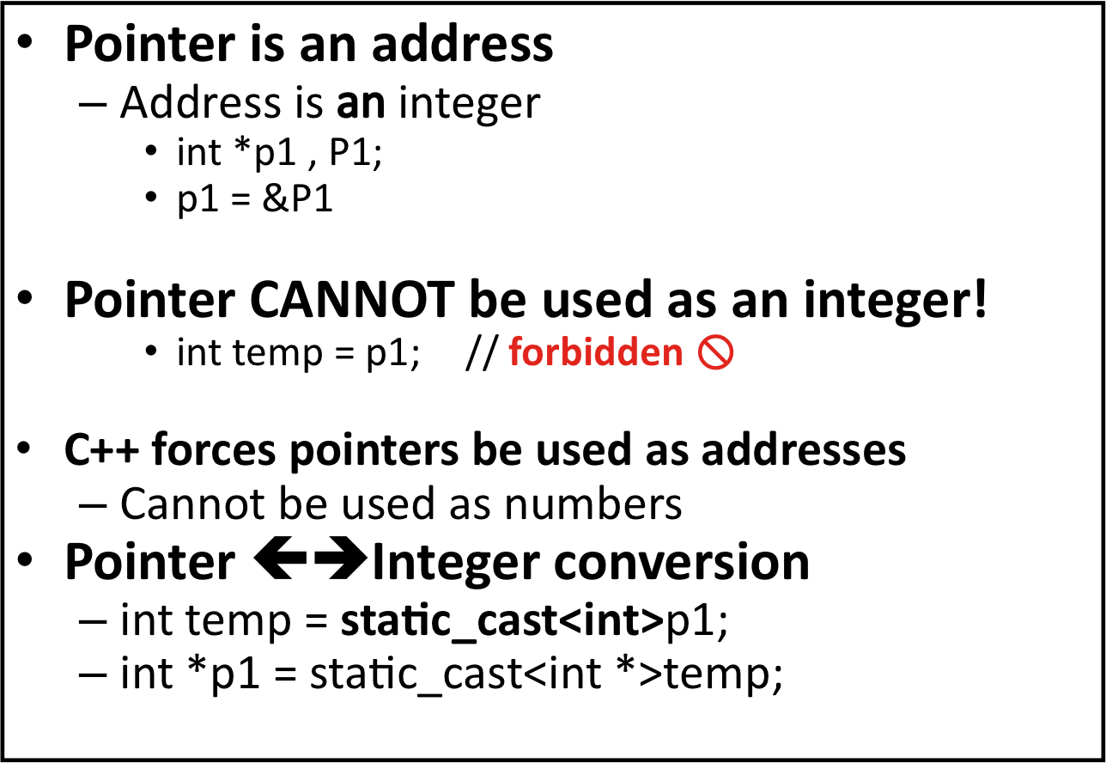
Addresses and Numbers
C++ Part II - Week#4

Slide 11
& Operator
The "address of" operator is overloaded
Used for obtaining the address of variable
  int *p1 = &P1;
Also used for declaring “alias”
  int& r_p1 = P1;
Also used to specify call-by-reference parameter
  Recall: call-by-reference parameters pass
  "address of" the actual argument
Operator’s two uses are closely related
C++ Part II - Week#4

Slide 12
Uses of the Assignment Operator with Pointer Variables
int X = 10, Y =20;
int *p1 = &X;
int *p1 = &y;
X = 10
(0X1000)
Y = 20
(0X1004)
::
::
::
P1 = & X1
(0X1000)
P2 = &Y
(0X1004)
C++ Part II - Week#4

Slide 13
* Operator
The ”*" operator is overloaded
Used for obtaining the address of variable
  int value1 = 100;
  int value2 = 500;
  int *p1 = &value1;
  int *p2= &vlaue2;
  int *t = p1;
  p1 = p2;
  *p1 = ???
  *p2 = ???
  p1 = t;
  P2 = p1;
C++ Part II - Week#4

Slide 14
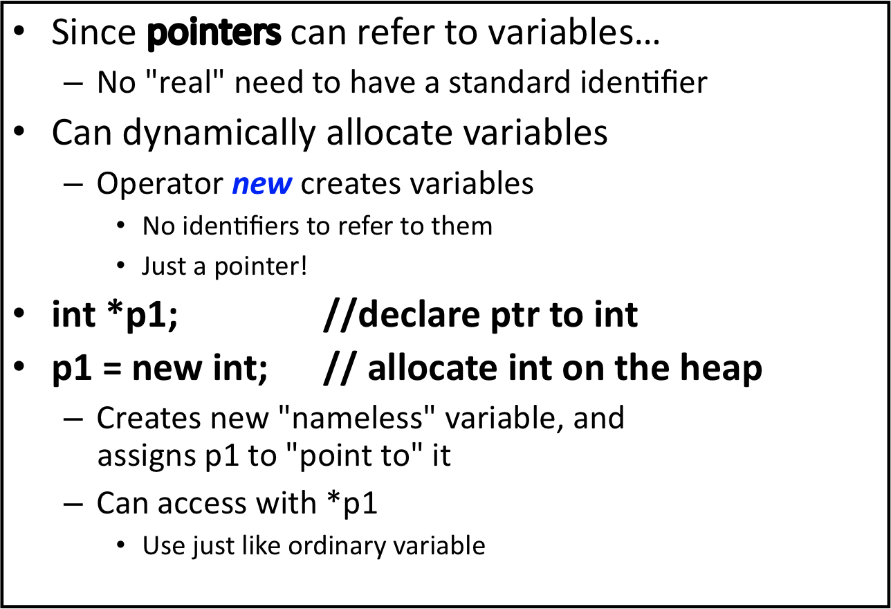
The new Operator
Text
__________
Global memory
__________
Stack
int *p;
p = new int;
__________
Heap
C++ Part II - Week#4

Slide 15
More on new Operator
new creates new dynamic variable on the heap
Returns pointer to the new variable
If new is used to create object:
  Constructor is called for new object after allocation of memory
  different constructors can be invokes
  MyClass *mcPtr;
  mcPtr = new MyClass; //case 1 – default cnstr
  mcPtr = new MyClass(32.0, 17); // case 2 – parameterized cnstr
Can still initialize native types:
int *n;
n = new int(17); //Initializes *n to 17
C++ Part II - Week#4

Slide 16
Object Creation
When a C++ object is created, two events occur:
  Memory storage is allocated for the object.
  The constructor is called to initialize that storage.
    It doesn’t matter where or how the object is created – the constructor is always called.
  Step 1, however, can occur in several ways, or at alternate times:
    Storage can be allocated before the program begins, in the static storage area. This storage exists for the life of the program.
    Storage can be created on the stack whenever a particular execution point is reached (an opening brace).
      That storage is released automatically at the complementary execution point (the closing brace).
      These stack-allocation operations are built into the instruction set of the processor and are very efficient. However, you have to know exactly how many variables you need when you’re writing the program so the compiler can generate the right code
    Storage can be allocated from a pool of memory called the heap (also known as the free store). This is called dynamic memory allocation. To allocate this memory, a function is called at runtime; this means you can decide at any time that you want some memory and how much you need..
C++ Part II - Week#4

Slide 17
C’s approach to the heap
To allocate memory dynamically at runtime, C provides functions in its standard library:
  malloc( ) ,calloc( ) and realloc( ) to produce memory from the heap
  free( ) to release the memory back to the heap.
These functions are pragmatic but primitive and require understanding and care on the part of the programmer.
Example:
#include <cstring> // memset()
#include <iostream>
using namespace std;
class Obj{
int i, j, k;
char buf[100];
public:
void initialize() {
cout << "initializing Obj" << endl; i = j = k = 0;
memset(buf, 0, sz); }
void destroy() const {
cout << "destroying Obj" << endl; }
};
int main() {
Obj* obj = (Obj*)malloc(sizeof(Obj));
obj->initialize();
// ... sometime later:
obj->destroy( );
free(obj);}
initializing Obj
destroying Obj
C++ Part II - Week#4

Slide 18
operators new & delete
When you create an object with new (using a new-expression)
  it allocates enough storage on the heap to hold the object
  calls the constructor for that storage.
    class X{ :::::::};
    X* X_ptr;
    X_ptr = new X;
When you delete an object with delete
  first calls the destructor and
  then releases the memory (often with a call to free( ))
    delete X_ptr;
  delete can be called only for an object created by new.
C++ Part II - Week#4

Slide 19
delete void* is probably a bug
if you call delete for a void*, it’s almost certainly going to be a bug in your program
Example
int main()
{
Object* a = new Object(40, 'a');
delete a;
void* b = new Object(40, 'b');
delete b;
}
OUTPUT:
Constructing object a, size = 40
Destructing object a
Constructing object b, size = 40
class Object {
void* data; // Some storage const
int size;
const char id;
public:
Object(int sz, char c) : size(sz), id©
{
data = new char[size];
cout << "Constructing object " << id << ", size = " << size << endl; }
~Object() {
cout << "Destructing object " << id << endl;
delete [ ]data; // OK, just releases storage, // no destructor calls are necessary }
};
delete a knows that a points to an Object, the destructor is called and thus the storage allocated for data is released.
C++ Part II - Week#4

Slide 20
Overloading new & delete
When you create an object using new two things occur
  The memory is allocated using operator new
  Then the constructor is called
When you destroy an object two things occur
  Destructor is called
  Memory is deallocated using operator delete
Typically constructor and destructor are never under your control
C++ Part II - Week#4

Slide 21
Overloading new & delete
Standard new and delete have been designed for general-purpose use
For situations where many objects are being created and destroyed, bottlenecks and fragmentation might be created by such scenarios
C++ allows the new and delete operators to be overloaded
  operator new( )
  operator delete( )
C++ Part II - Week#4

Slide 22
Overloading new & delete
operator new( ) and operator delete( ) change only the way raw storage is allocated
  Compiler will invoke user-defined new instead of default new and then invoke the constructor
There are various scenarios for overloading new and delete operator:
  Overloading global new & delete
    Drastic approach
  Overloading new & delete for a class
    Large pool of memory is created to hold an array of objects
  Overloading new & delete for arrays
    Only one constructor and destructor are invoked
  Placement new & delete
    Placing object in specific location
C++ Part II - Week#4

Slide 23
Overloading global new & delete
This is the drastic version where your overload the global versions of new and delete
  void * operator new(size_t sz )
  void operator delete(void *)
The default new and delete are completely inaccessible
The argument to new (size_t sz) is generated by the compiler and is the size of object you are trying to create
void* is the return value of operator new( )
  Gets the pointer after constructor is called
void is the return value of operator delete( )
  Gets the pointer after destructor is called
C++ Part II - Week#4

Slide 24
Overloading global new & delete
#include <stdio.h>
#include <stdlib.h>
void * operator new(size_t sz){ //compiler generated
printf("Operator new: %d Bytes\n", sz);
void* m = malloc(sz);
if(m == NULL)
printf("Out of Memory\n");
return m;
}
void operator delete(void* m){
printf("Operator delete\n");
free(m);
}
class S{
int i[100]; //contains some internal data
public:
S( ){printf("Default constructor\n");}
~S( ) {printf("Destructor\n");}
};
int main( ) {
printf(”Creating and destroying an int\n");
int *p = new int(47); //init value to 47
delete p;
printf("Creating and destroying s\n");
S *s = new S;
delete s;
printf("Creating and destroying S[3]\n");
S *sa = new S[3];
delete [ ]s;
}/*********************** Results ************************/
./New_Global
Crating and destroying an int
Operator new: 4 Bytes
Operator delete
Creating and destroying s
Operator new: 400 Bytes
Default constructor
Destructor
Operator delete
Creating and destroying S[3]
Operator new: 1204 Bytes
Default constructor
Default constructor
Default constructor
Destructor
Destructor
Destructor
Operator delete
C++ Part II - Week#4

Slide 25
Overloading new & delete for a class
A particular strategy that can be exploited when working with array of objects that need to be dynamically allocated is to create a pool of memory in the static data area at program startup and that memory is used to allocate space for objects using overloaded operator new( ) that works in conjunction with that pool.
class X{ …… };
int main( ){
X* X_ptr[N]; // declare array of pointers to X
for(i = 0; i < N; i++)
X_ptr[i] = new X; //overloaded new operator
} // maps each X_ptr[i] to distinct blocks
// in static data area – reduces overhead
// cost of allocation & fragmentation
C++ Part II - Week#4

Slide 26
Overloading new & delete for a class
#include <stdio.h>
class X{
enum {sz = 10};
char c[sz];
static unsigned char pool[ ]; //mem pool
static bool alloc_map[ ];
public:
enum{ psize = 5};
X( ) {printf("Default constructor\n");}
~X( ){printf("Destructor\n");}
void* operator new(size_t);
void operator delete(void *);
};
//create pool of memory
unsigned char X::pool[psize * sizeof(X)];
bool X::alloc_map[psize] = {false};
void* X::operator new(size_t sz) { //size ignored
for(int i = 0; i < psize; i++)
if(!alloc_map[i]){
printf("using block %d ....\n", i);
alloc_map[i] = true; // mark it used
return pool + (i * sizeof(X) );
}
}
void X::operator delete(void *m){
if(!m) return; //Check for NULL Pointer
// Assume it was created in the pool
// Calculate block #
unsigned long block = (unsigned long)m - (unsigned long)pool;
block /= sizeof(X);
printf("Freeing Block %d\n", block);
alloc_map[block] = false; // Mark it free
}
int main( ){
X* X_ptr[X::psize]; //array of pointers
int i;
int j;
for(i = 0; i < X::psize; i++) {
X_ptr[i] = NULL;
X_ptr[i] = new X;
if(X_ptr == NULL){
printf("Out of Memory\n"); }
}
delete X_ptr[4]; //arbitrary deallocate
X_ptr[4] = 0;
for(j = 0; j < X::psize; j++)
delete X_ptr[j]; //delete X[4] OK
}
C++ Part II - Week#4

Slide 27
Overloading new & delete for a class
int main( ){
X* X_ptr[X::psize];
int i;
int j;
for(i = 0; i < X::psize; i++) {
X_ptr[i] = NULL;
X_ptr[i] = new X;
if(X_ptr == NULL){
printf("Out of Memory\n");
}
}
delete X_ptr[2]; //arbitrary deallocate
X_ptr[2] = 0;
for(j = 0; j < X::psize; j++)
delete X_ptr[j]; //delete X[4] OK
}
/************************** Results ******************/
/New_Class
using block 0 ....
Default constructor
using block 1 ....
Default constructor
using block 2 ....
Default constructor
using block 3 ....
Default constructor
using block 4 ....
Default constructor
Destructor
Freeing Block 2
Destructor
Freeing Block 0
Destructor
Freeing Block 1
Destructor
Freeing Block 3
Destructor
Freeing Block 4
C++ Part II - Week#4

Slide 28
Overloading new & delete for arrays
The strategy for dynamically allocating an array of objects can be enhanced via overloaded new/delete operators
  The overloaded new() operator is called to allocate enough storage for the array all at once.
  Likewise the overloaded operator delete( ) is called to release the storage
  You can control the allocation of arrays by overloading the special versions of
    operator new[ ]
    operator delete[ ]
C++ Part II - Week#4

Slide 29
Overloading new & delete for arrays
#include <stdio.h>
#include <new>
class X{
enum {sz = 10};
int i[sz];
public:
X( ) {printf("*Default constructor\n");}
~X( ){printf("~Destructor\n");}
void* operator new(size_t sz)
{
printf("X::new: %d Bytes\n", sz);
return ::new char[sz]; //get chunk of mem
}
void operator delete(void* p){
printf("X::delete\n");
::delete [ ]p;
}
//Size is ignored - assume object X
void* operator new[ ](size_t sz) {
printf("X::new: %d Bytes\n", sz);
return ::new char[sz];
}
void operator delete[ ](void* p){
printf("X::delete[] : \n");
::delete [ ]p;
}
};
int main( ){
printf("New X\n");
X* X_ptr = new X;
printf("Delete X\n");
delete X_ptr;
printf("\nnew X[5]\n");
X_ptr = new X[5];
printf("\ndelete []X\n");
delete [ ]X_ptr;
}
/************************** Results ***************************
/New X
X::new: 40 Bytes
*Default constructor
Delete X
~Destructor
X::delete
new X[5]
X::new: 204 Bytes
*Default constructor
*Default constructor
*Default constructor
*Default constructor
*Default constructor
delete []X
~Destructor
~Destructor
~Destructor
~Destructor
~Destructor
X::delete[] :
C++ Part II - Week#4

Slide 30
Pointers and Functions
Pointers are full-fledged types
  Can be used just like other types
Can be used as function parameters
Can be returned from functions
Example:
int* findOtherPointer(int* p);
  This function declaration:
    Has "pointer to an int" parameter
    Returns "pointer to an int" variable
C++ Part II - Week#4

Slide 31
Memory Management
Heap
  Also called "freestore"
  Reserved for dynamically-allocated variables
  All new dynamic variables consume memory
  in freestore
    If too many → could use all freestore memory
Future "new" operations will fail if freestore
is "full"
C++ Part II - Week#4

Slide 32
Checking new Success
Older compilers:
  Test if null returned by call to new:
  int *p;
  p = new int;
  if (p == NULL)
  {
  cout << "Error: Insufficient memory.\n";
  exit(1);
  }
  If new succeeded, program continues
C++ Part II - Week#4

Slide 33
new Success – New Compiler
Newer compilers:
  If new operation fails:
    Program terminates automatically
    Produces error message
Still good practice to use NULL check
C++ Part II - Week#4

Slide 34
Freestore (Heap) Size
Varies with implementations
Typically large
  Most programs won’t use all memory
Memory management
  Still good practice
  Solid software engineering principle
  Memory IS finite
    Regardless of how much there is!
C++ Part II - Week#4

Slide 35
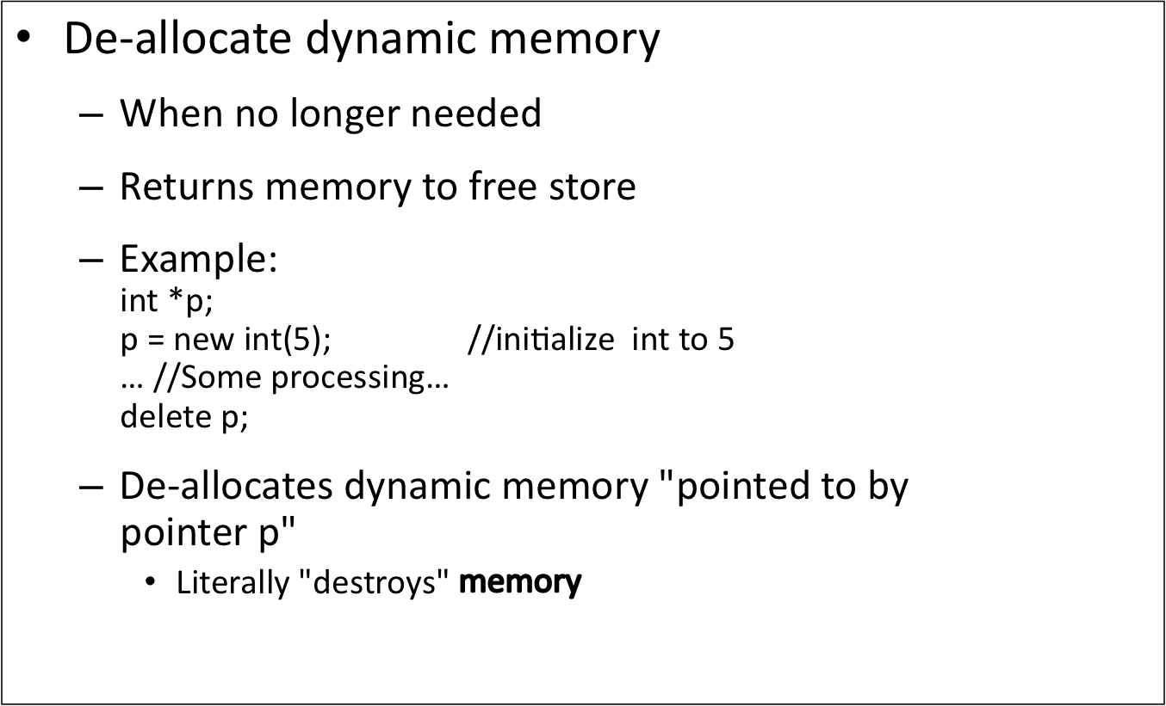
delete Operator
C++ Part II - Week#4

Slide 36
Dangling Pointers
delete p;
  Destroys dynamic memory
  But p still points there!
    Called "dangling pointer"
  If p is then dereferenced ( *p )
    Unpredicatable results!
    Often disastrous!
Avoid dangling pointers
  Assign pointer to NULL after delete:
  delete p;
  p = NULL;
  delete p; //safe – nothing happens
C++ Part II - Week#4

Slide 37
Dynamic and Automatic Variables
Dynamic variables
  Created with new operator
  Created and destroyed while program runs
Local variables
  Declared within function definition
  Not dynamic
    Created when function is called
    Destroyed when function call completes
  Often called "automatic" variables
    Properties controlled for you
C++ Part II - Week#4

Slide 38
Define Pointer Types
Can "name" pointer types
To be able to declare pointers like other
variables
  Eliminate need for "*" in pointer declaration
typedef int* IntPtr;
  Defines a "new type" alias
  Consider these declarations:
  IntPtr p;
  int *p;
    The two are equivalent
C++ Part II - Week#4

Slide 39
Pitfall: Call-by-value Pointers
Behavior subtle and troublesome
  If function changes pointer parameter
  itself → only change is to local copy
Best illustrated with example…
C++ Part II - Week#4

Slide 40
Dynamic Arrays
Array variables
  Really pointer variables!
Standard array
  Fixed size
Dynamic array
  Size not specified at programming time
  Determined while program running
C++ Part II - Week#4

Slide 41
Array Variables
Recall: arrays stored in memory
addresses, sequentially
  Array variable "refers to" first indexed variable
  So array variable is a kind of pointer variable!
Example:
int a[10];
int * p;
  a and p are both pointer variables!
C++ Part II - Week#4

Slide 42
Array Variables → Pointers
Recall previous example:
int a[10];
typedef int* IntPtr;
IntPtr p;
a and p are pointer variables
  Can perform assignments:
  p = a; // Legal.
    p now points where a points
      To first indexed variable of array a
  a = p; // Illegal!
    Array pointer is CONSTANT pointer!
C++ Part II - Week#4

Slide 43
Array Variables → Pointers
Array variable
int a[10];
MORE than a pointer variable
  "const int *" type
  Array was allocated in memory already
  Variable a MUST point there…always!
    Cannot be changed!
In contrast to ordinary pointers
  Which can (& typically do) change
C++ Part II - Week#4

Slide 44
Dynamic Arrays
Array limitations
  Must specify size first
  May not know until program runs!
Must "estimate" maximum size needed
  Sometimes OK, sometimes not
  "Wastes" memory
Dynamic arrays
  Can grow and shrink as needed
C++ Part II - Week#4

Slide 45
Creating Dynamic Arrays
Very simple!
Use new operator
  Dynamically allocate with pointer variable
  Treat like standard arrays
Example:
typedef double * DoublePtr;
DoublePtr d;
d = new double[10]; //Size in brackets
  Creates dynamically allocated array variable d,
  with ten elements, base type double
C++ Part II - Week#4

Slide 46
Deleting Dynamic Arrays
Allocated dynamically at run-time
  So should be destroyed at run-time
Simple again. Recall Example:
d = new double[10];
… //Processing
delete [] d;
  De-allocates all memory for dynamic array
  Brackets indicate "array" is there
  Recall: d still points there!
    Should set d = NULL;
C++ Part II - Week#4

Slide 47
Function that Returns an Array
Array type NOT allowed as return-type of function
Example:
int [] someFunction(); // ILLEGAL!
Instead return pointer to array base type:
int* someFunction(); // LEGAL!
C++ Part II - Week#4

Slide 48
Pointer Arithmetic
Can perform arithmetic on pointers
  "Address" arithmetic
Example:
typedef double* DoublePtr;
DoublePtr d;
d = new double[10];
  d contains address of d[0]
  d + 1 evaluates to address of d[1]
  d + 2 evaluates to address of d[2]
    Equates to "address" at these locations
C++ Part II - Week#4

Slide 49
Alternative Array Manipulation
Use pointer arithmetic!
"Step thru" array without indexing:
for (int i = 0; i < arraySize; i++)
cout << *(d + I) << " " ;
Equivalent to:
for (int i = 0; i < arraySize; i++)
cout << d[I] << " " ;
Only addition/subtraction on pointers
  No multiplication, division
Can use ++ and -- on pointers
C++ Part II - Week#4

Slide 50
Multidimensional Dynamic Arrays
Yes we can!
Recall: "arrays of arrays"
Type definitions help "see it":
typedef int* IntArrayPtr;
IntArrayPtr *m = new IntArrayPtr[3];
  Creates array of three pointers
  Make each allocate array of 4 ints
for (int i = 0; i < 3; i++)
m[i] = new int[4];
  Results in three-by-four dynamic array!
C++ Part II - Week#4

Slide 51
Back to Classes
The -> operator
  Shorthand notation
Combines dereference operator, *, and
dot operator
Specifies member of class "pointed to"
by given pointer
Example:
MyClass *p;
p = new MyClass;
p->grade = "A"; Equivalent to:
(*p).grade = "A";
C++ Part II - Week#4

Slide 52
The this Pointer
Member function definitions might need to refer to calling object
Use predefined this pointer
  Automatically points to calling object:
  Class Simple
  {
  public:
  void showStuff() const;
  private:
  int stuff;
  };
Two ways for member functions to access:
cout << stuff;
cout << this->stuff;
C++ Part II - Week#4

Slide 53
Overloading Assignment Operator
Assignment operator returns reference
  So assignment "chains" are possible
  e.g., a = b = c;
    Sets a and b equal to c
Operator must return "same type" as it’s
left-hand side
  To allow chains to work
  The this pointer will help with this!
C++ Part II - Week#4

Slide 54
Overloading Assignment Operator
Recall: Assignment operator must be
member of the class
  It has one parameter
  Left-operand is calling object
  s1 = s2;
    Think of like: s1.operator=(s2);
s1 = s2 = s3;
  Requires s1 =( s2 = s3);
  So (s2 = s3) must return object of s1"s type
    And pass to " = s1";
C++ Part II - Week#4

Slide 55
Overloaded = Operator Definition
Uses string Class example:
StringClass& StringClass::operator=(const StringClass& rtSide)
{
if (this == &rtSide) // if right side same as left side
return *this;
else
{
capacity = rtSide.length;
length
length = rtSide.length;
delete [] a;
a = new char[capacity];
for (int I = 0; I < length; I++)
a[I] = rtSide.a[I];
return *this;
}
}
C++ Part II - Week#4

Slide 56
Shallow and Deep Copies
Shallow copy
  Assignment copies only member variable
  contents over
  Default assignment and copy constructors
Deep copy
  Pointers, dynamic memory involved
  Must dereference pointer variables to
  "get to" data for copying
  Write your own assignment overload and
  copy constructor in this case!
C++ Part II - Week#4

Slide 57
Destructor Need
Dynamically-allocated variables
  Do not go away until "deleted"
If pointers are only private member data
  They dynamically allocate "real" data
    In constructor
  Must have means to "deallocate" when
  object is destroyed
Answer: destructor!
C++ Part II - Week#4

Slide 58
Destructors
Opposite of constructor
  Automatically called when object is out-of-scope
  Default version only removes ordinary
  variables, not dynamic variables
Defined like constructor, just add ~
  MyClass::~MyClass()
  {
  //Perform delete clean-up duties
  }
C++ Part II - Week#4

Slide 59
Copy Constructors
Automatically called when:
  Class object declared and initialized to other object
  When function returns class type object
  When argument of class type is "plugged in"
  as actual argument to call-by-value parameter
Requires "temporary copy" of object
  Copy constructor creates it
Default copy constructor
  Like default "=", performs member-wise copy
Pointers → write own copy constructor!
C++ Part II - Week#4

Slide 60
Summary
Pointer is memory address
  Provides indirect reference to variable
Dynamic variables
  Created and destroyed while program runs
Freestore
  Memory storage for dynamic variables
Dynamically allocated arrays
  Size determined as program runs
C++ Part II - Week#4

Slide 61
Summary
Class destructor
  Special member function
  Automatically destroys objects
Copy constructor
  Single argument member function
  Called automatically when temp copy needed
Assignment operator
  Must be overloaded as member function
  Returns reference for chaining
C++ Part II - Week#4

